Slide 1


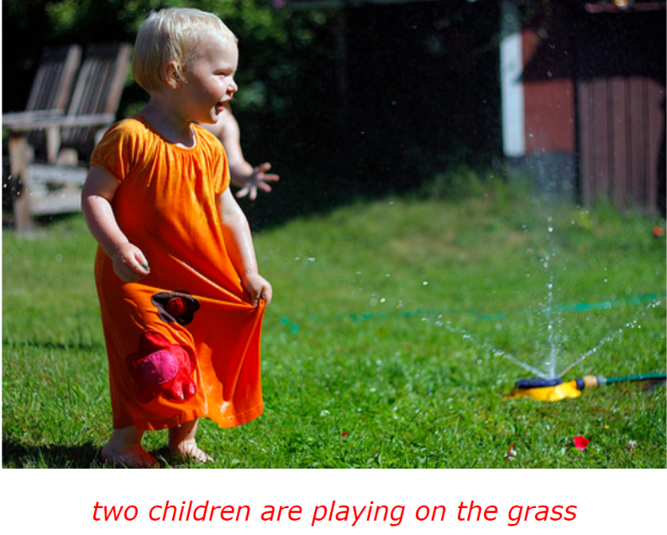
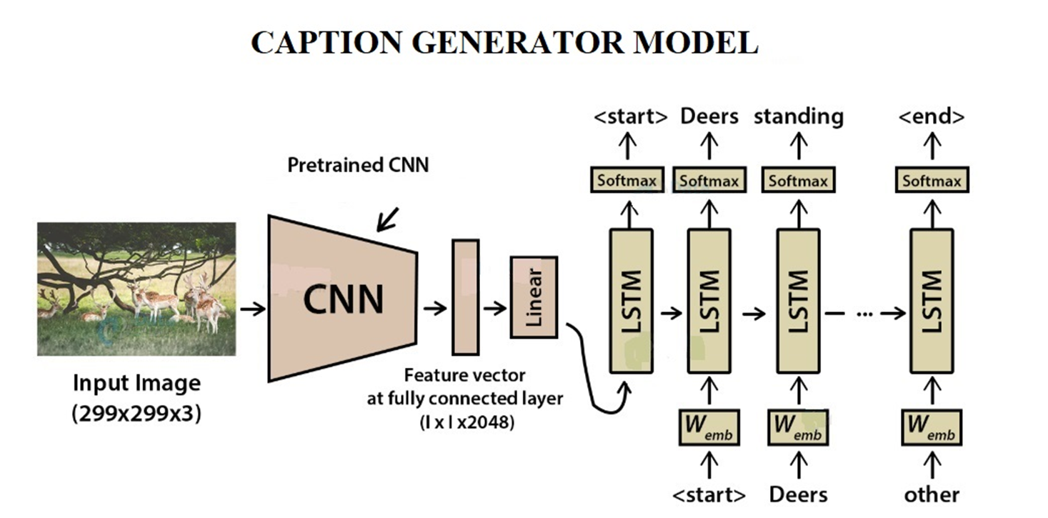
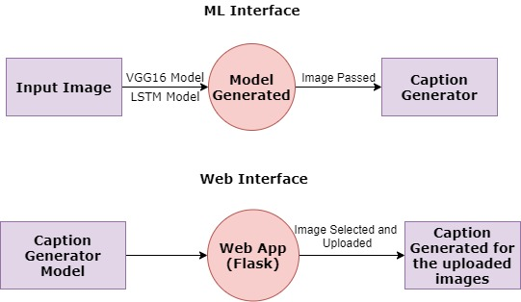
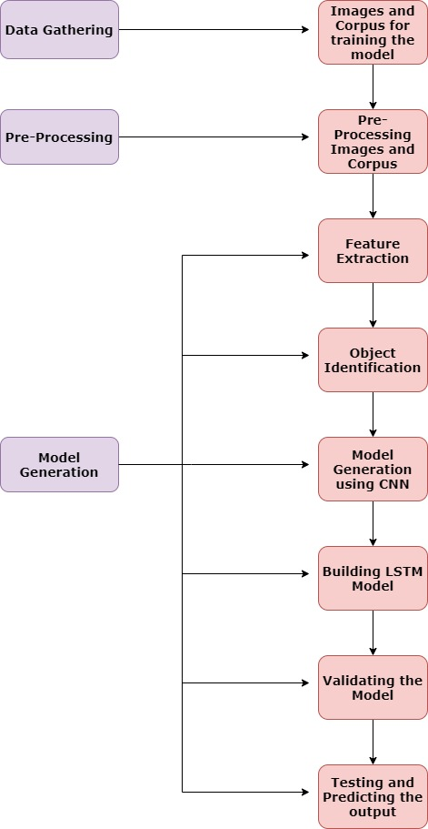
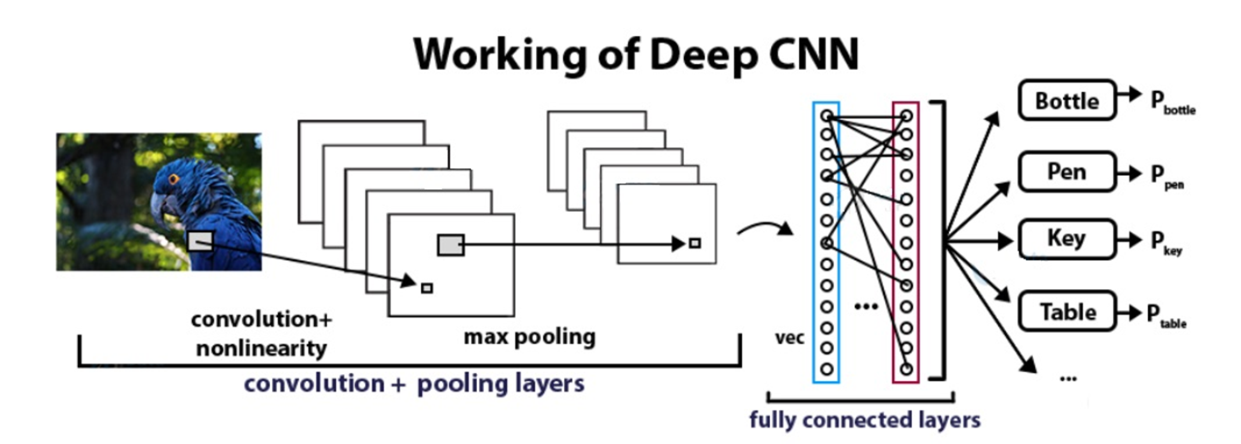
Caption Generator By: Vijaykumar R Pai, 6th Semester, MCA, PES University Guide: Dr. Thenmozhi S Chairperson: Dr. Veena S
Abstract
Results
Methodology
Caption Generator is a Machine Learning application which identifies the action portrayed in the given image. The generated caption will describe about the image that will say what kind of actions is taking place in it.
This project involves computer vision and natural language processing concepts to recognize the context of an image and describe them in a natural language like English.
The objective of the project is to build a working model of Caption Generator by implementing CNN with LSTM.
Objectives
Future Enhancements
Distorted and blurred images can also be considered.
Caption Generation should work for video also.
A Mobile Application can be developed that will make the user more convenient to use.
In the future, some hybrid algorithms can be used to achieve a higher accuracy that will help in better generation of captions for the images.
Data Pre-Processing and Model Generation
Working of CNN Model
Conclusion
The objective of the project was to identify the action portrayed in the given image. The generated caption will describe the image that will say what kind of actions is taking place in it.
It will be helpful for visually impaired people as they will know what kind of image it is and the kind of action taking place in it.
This has been solved with my application as it provides a service to users that helps in generating captions for any images of their choice once they upload it in my application.

